Slide 1




DECODING EMOTIONAL PRESSURE IN SOCIAL INTERACTIONS VIA NLP MODELS
SUBMITTED BY:
GROUP - 07
SUBMITTED TO:
NIRNOY CHANDRA SARKER (20101043)
JENNIFER ABEDIN (20301219)
ISHRAT JAHAN (20301152)
Annajiat Alim Rasel (AAR)
Senior Lecturer
Adib Muhammad Amit
Research Assistant

Slide 2







TABLE OF CONTENT
01
02
03
INTRODUCTION
LITERATURE REVIEW
LIMITATIONS
04
05
FUTURE WORK
CONCLUSION

Slide 3


INTRODUCTION
"Decoding Emotional Pressure in Social Interactions via NLP Models" represents a significant exploration in natural language processing (NLP), focusing on unraveling the complexities of emotional pressure within social interactions.

Slide 4



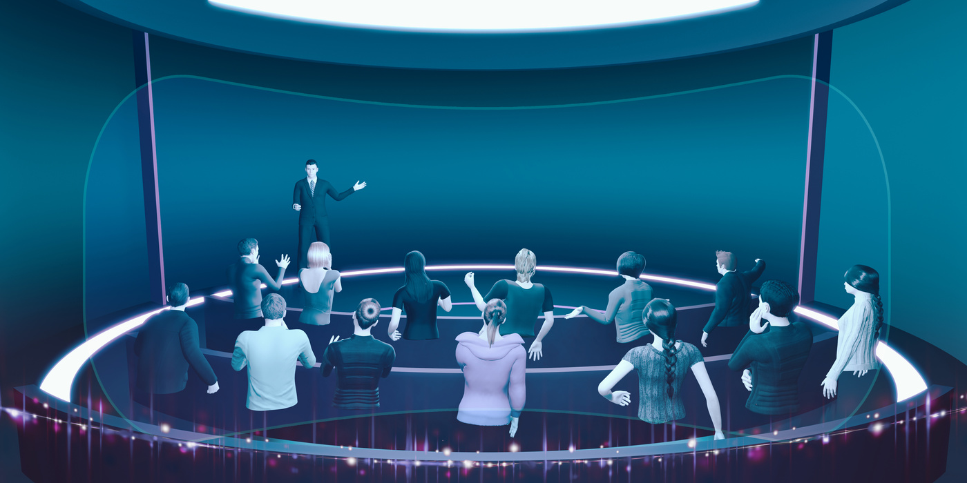


LITERATURE
REVIEW
THE PAPER TITLED “ENSEMBLE OF GATED RECURRENT UNIT AND CONVOLUTIONAL NEURAL NETWORK FOR
SARCASM DETECTION IN BANGLA“ RESULTS DEMONSTRATE AN AVERAGE ACCURACY OF 90.62% AND AN F1 SCORE
OF 90.33% ON A STANDARD DATASET.
THE PAPER "EVALUATION OF CHATGPT FOR NLP-BASED MENTAL HEALTH APPLICATIONS" INVESTIGATES THE EFFECTIVENESS OF CHATGPT, A LARGE LANGUAGE MODEL (LLM), IN TEXT-BASED MENTAL HEALTH CLASSIFICATION TASKS.
THE SURVEY ON “DEEP LEARNING TECHNIQUES ON TEXT CLASSIFICATION USING NATURAL LANGUAGE PROCESSING (NLP) IN SOCIAL HEALTHCARE NETWORK: A COMPREHENSIVE SURVEY” EXPLORES THE INTERSECTION OF ADVANCED AI AND HEALTHCARE COMMUNICATION.

Slide 5




LIMITATIONS
BIASED DATA & MISINFORMATION: WHEN DATASETS CONTAIN BIASES, MODELS MAY FIND IT DIFFICULT TO DETECT DATA INTEGRITY AND MAY PROVIDE MISLEADING ACCURACY AS A RESULT OF FAILING TO CAPTURE DATA COMPLEXITY. THIS LEADS TO BIASED SENTIMENT ANALYSIS.
ABSENCE OF CONTEXT: INACCURATE FINDINGS AND ACCURACY MAY ARISE FROM A DATASET WITHOUT CONTEXT.
SCALABILITY AND PERFORMANCE OPTIMIZATION: TO PREVENT OVERFITTING OR UNDERFITTING, MERGED DATASETS MUST BE SCALED AND REQUIRE
EFFECTIVE CODE OPTIMIZATION.

Slide 6

FUTURE Work
Future endeavors in this research area should address existing limitations and extend the capabilities of NLP models in decoding emotional pressure.
ENHANCING MODEL GENERALIZATION
REAL-TIME APPLICATIONS AND INTERVENTION
ETHICAL CONSIDERATIONS AND BIAS MITIGATION

Slide 7
CONCLUSION
"Decoding Emotional Pressure in Social Interactions via NLP Models" presents a pioneering effort to imbue artificial intelligence with the ability to understand and respond to emotional pressure in human conversations. Despite acknowledged limitations, the research lays the groundwork for future developments in emotionally intelligent AI systems.

Slide 8
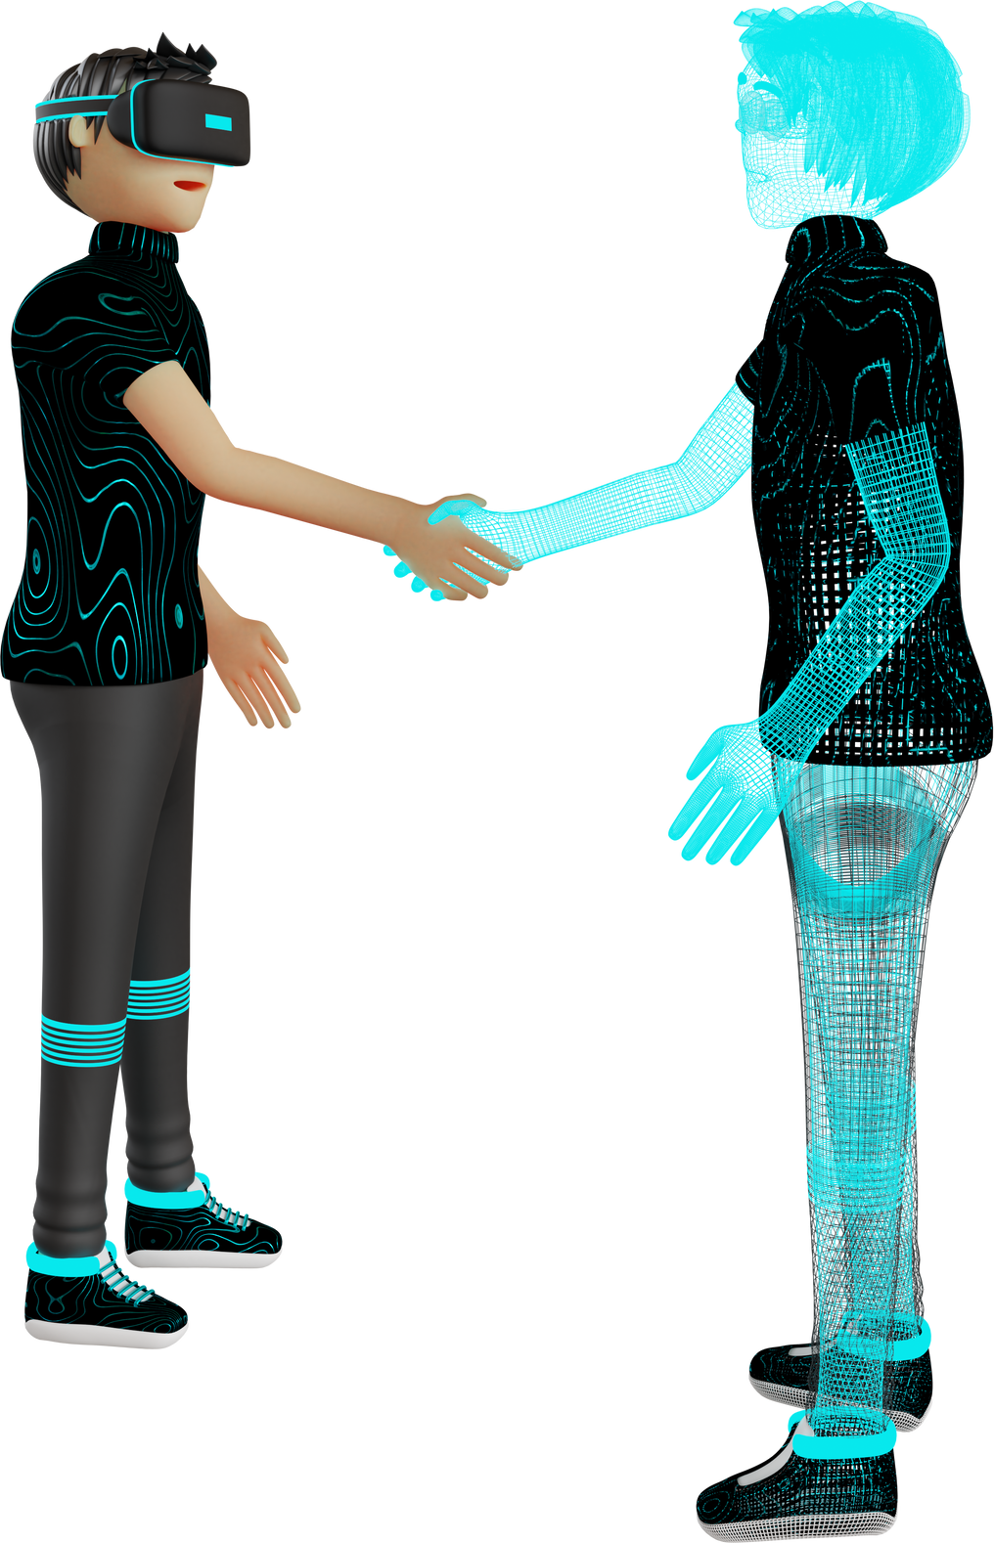

THANK YOU

